Slide 1
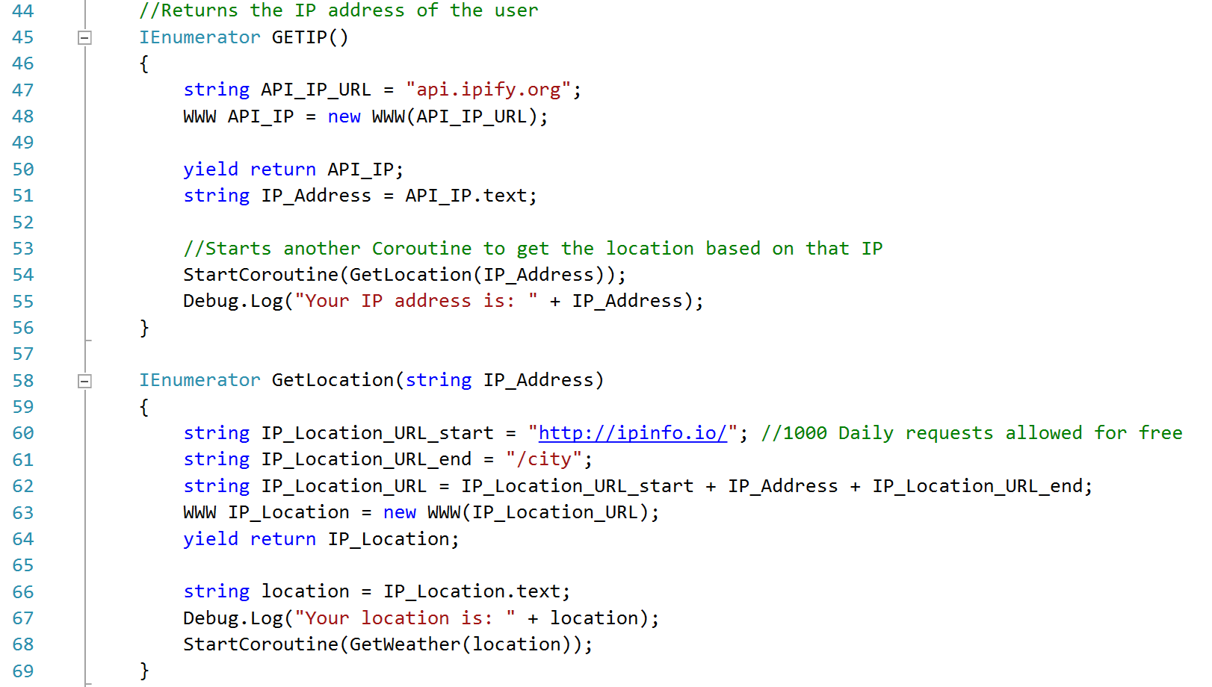
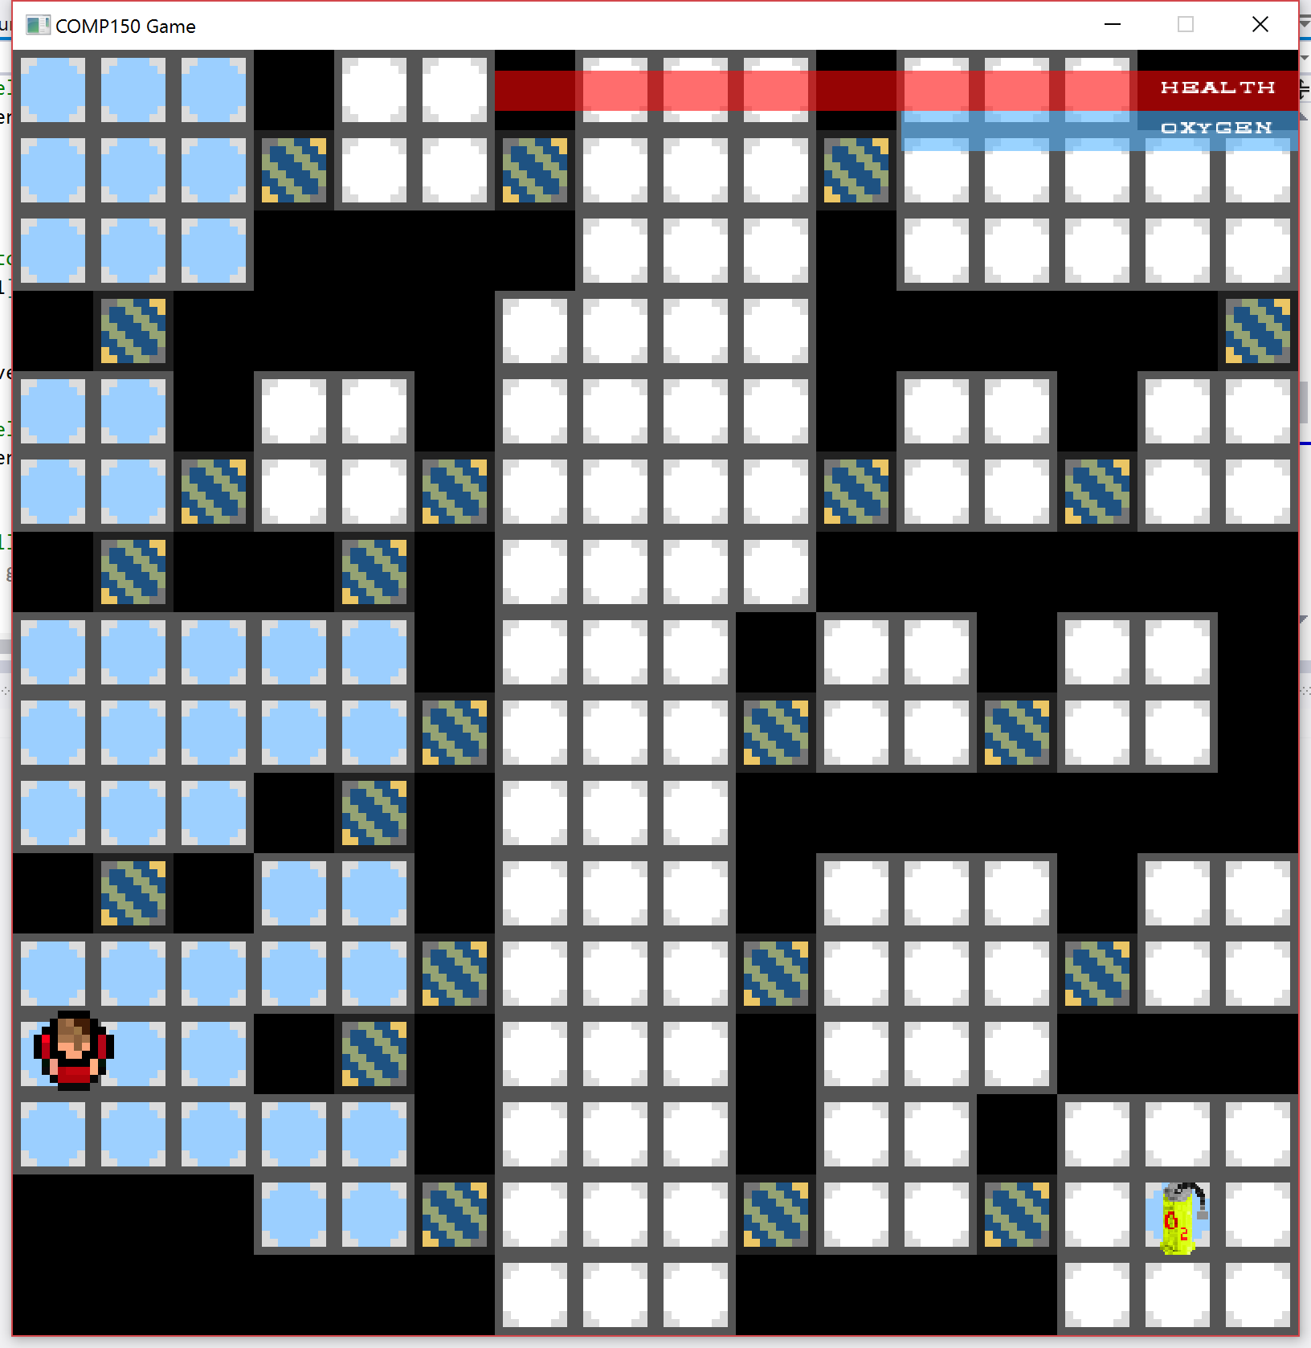
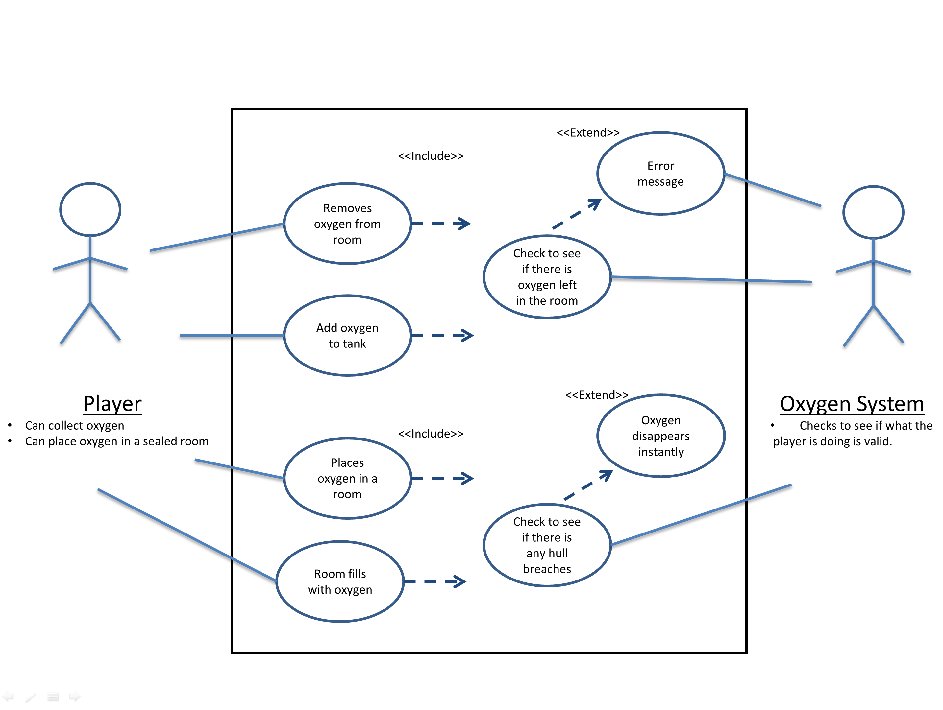
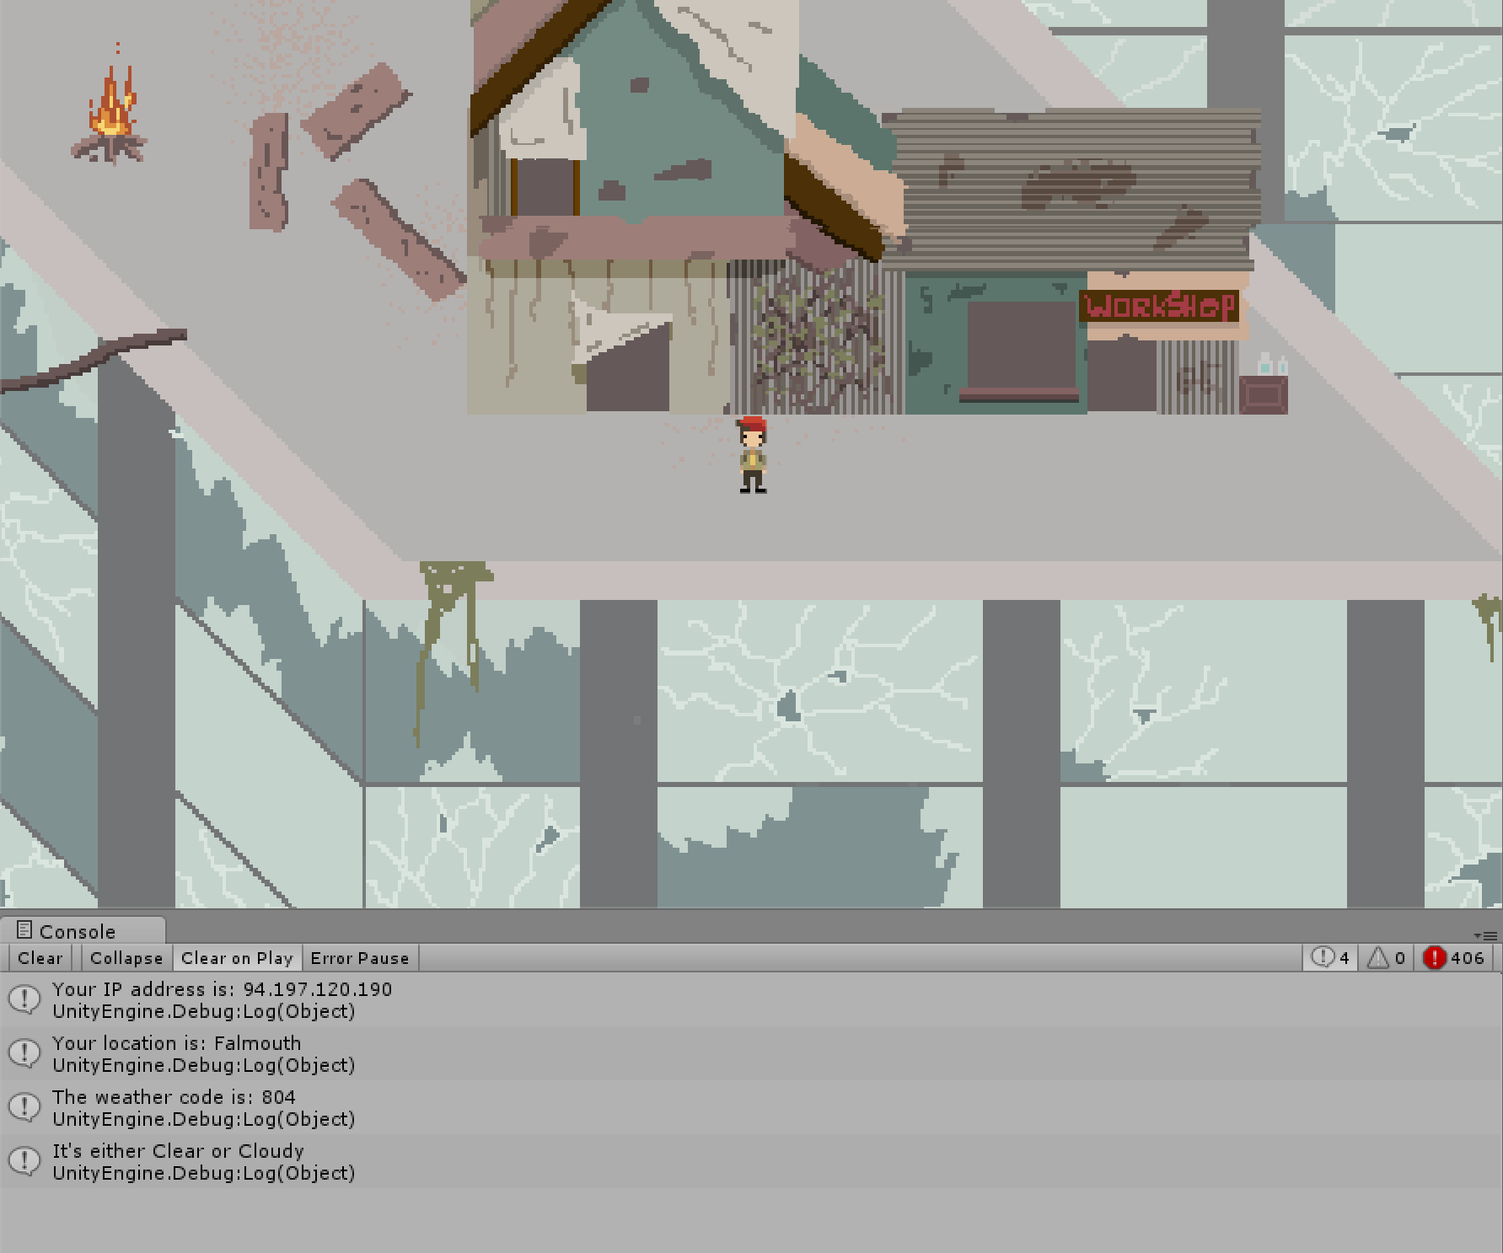
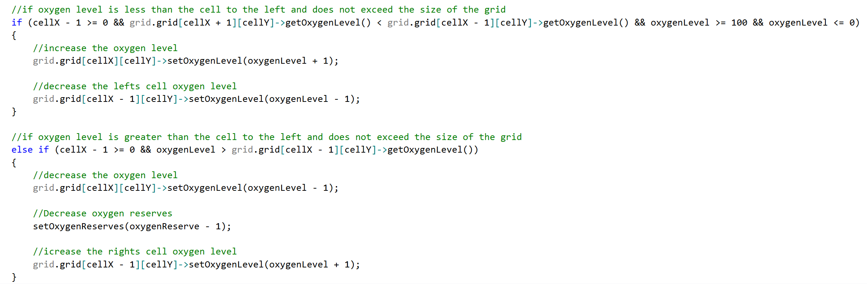
Coding Task II & Weather API
Oxygen Coding Task II
Weather API
This weather API for the BA game Relics.
This script will check the players location based on their IP address and then use a weather API to set the weather to the players current weather at their location.
For the comp150 game I focused on the oxygen mechanic, this involved adding oxygen to cells in the game, and then that oxygen will spread to neighbouring cells and then that would fill a room with oxygen.
This is the code that checks the IP address and location of the player.
This weather API integrated three separate APIs together. First it checked the users external IP address with:
http://api.ipify.org/
Then it got the location of the user with:
http://ipinfo.io/
Then it gets the weather with:
http://openweathermap.org
This is the final game, with oxygen placed in some of the rooms.
Use Case Diagram of the oxygen system.
Sample bit of code that checks the neighbouring cells oxygen value
An Image of the code working in game and setting the weather to clear

